Slide 1
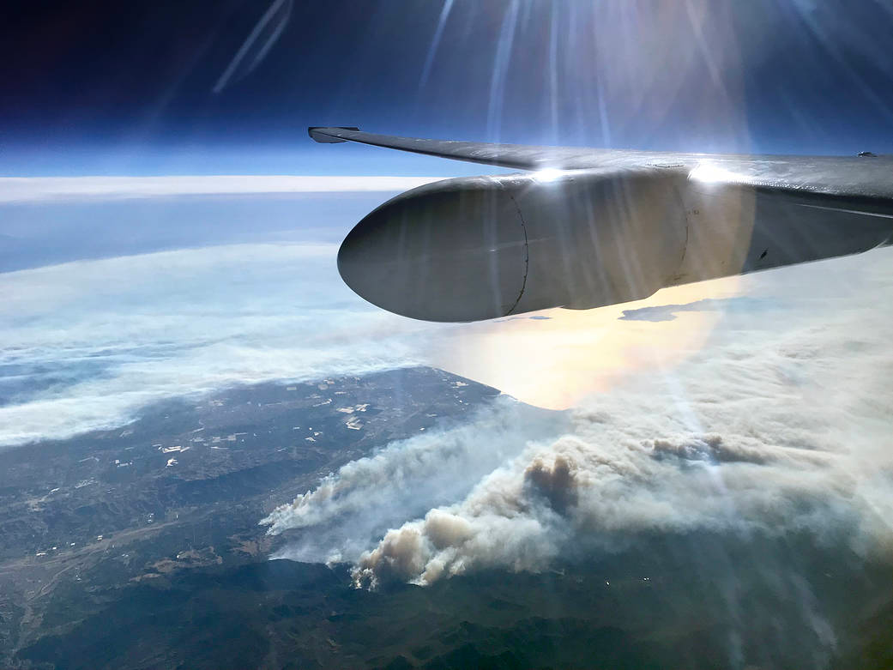
Machine learning for spatiotemporal PM_{2.5} estimates across the western US, 2008-2014
Melissa May Maestas, PhD
Research Associate (Post-Doctoral)
CU Boulder, CIRES, Earth Lab
International Workshop on Air Quality Forecasting Research
November 9, 2018
Boulder, CO
Colleen E. Reid, PhD, MPH
Assistant Professor of Geography
CU Boulder
Ellen Considine
BS-candidate
Gina Li
MA-candidate
Image: https://www.nasa.gov/image-feature/nasas-science-aircraft-flies-over-thomas-fire-in-california
Notes:
Hello, I’m Melissa Maestas, and I would like to tell you about a project that my research group is working on. First, I’d like to acknowledge my colleagues. Colleen Reid is the PI for the group and she is faculty in both the Institute for Behavioral Science and Geography at CU Boulder. Ellen Considine is an undergrad in applied mathematics and Gina Li is an MA student in Geography, and they have both put in a tremendous amount of work for this project. This session is Emerging Topics in AQ Forecasting, and the results from the project I’ll be discussing are still very much emerging, so please keep in mind that what I’ll be showing is still very preliminary.

Slide 2
Why wildfires?
Globally and regionally, wildfire risk is projected to increase under various potential future climate scenarios.
The percent of our air pollution due to wildfires will likely increase, not just from climatic changes, but also because of declines in other sources of air pollution
Image: McClure and Jaffe, 2018. www.pnas.org/cgi/doi/10.1073/pnas.1804353115
Notes:
Our group is very interested in the health effects of wildfires. [read points and describe figure]
Caption from paper: Fig. 1. The 98th Quantile Regression of PM2.5 trends. Observed PM trends for 1988–2016 (calculated using QR methods) from IMPROVE sites are shown by
black dots with corresponding values in μg·m−3·y−1. Krige-interpolated values (calculated from observed data) are shown by the color ramp. Solid black lines
with arrows (indicating direction) show the boundary where the Krige-interpolated PM2.5 trends within have a 90% probability of being positive or negative.
Of the 157 sites, 92 show statistical significance (8 positive/84 negative).

Slide 3
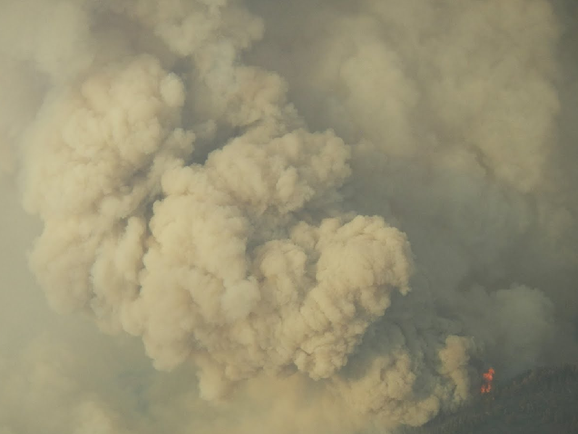
What are the health effects from exposure to wildfire smoke?
Clear evidence of respiratory health effects
Particularly for exacerbation of asthma
Growing evidence of increased risk of all-cause mortality
Mixed findings for cardiovascular outcomes
A few studies have found associations with adverse birth outcomes
More research needed
Health outcomes not yet studied or understudied
Further evaluate cardiovascular outcomes
Better understand effects of duration and intensity of wildfire smoke exposures
Identify vulnerable subpopulations
Source: Reid et al. 2016. Critical review of health impacts of wildfire smoke exposure. Environmental Health Perspectives
Image: National Fire Interagency Fire Center
Notes:
From a health perspective, there are impacts on the people living closest to the fire in terms of loss of life and psychological trauma from living through an extreme weather event, and from wildland firefighters in terms of their inhalation and physical exposures to fire, however, our research is focused on the effects on the population living downwind and experiencing higher than average air pollution exposures. A previous review by Colleen Reid found …

Slide 4
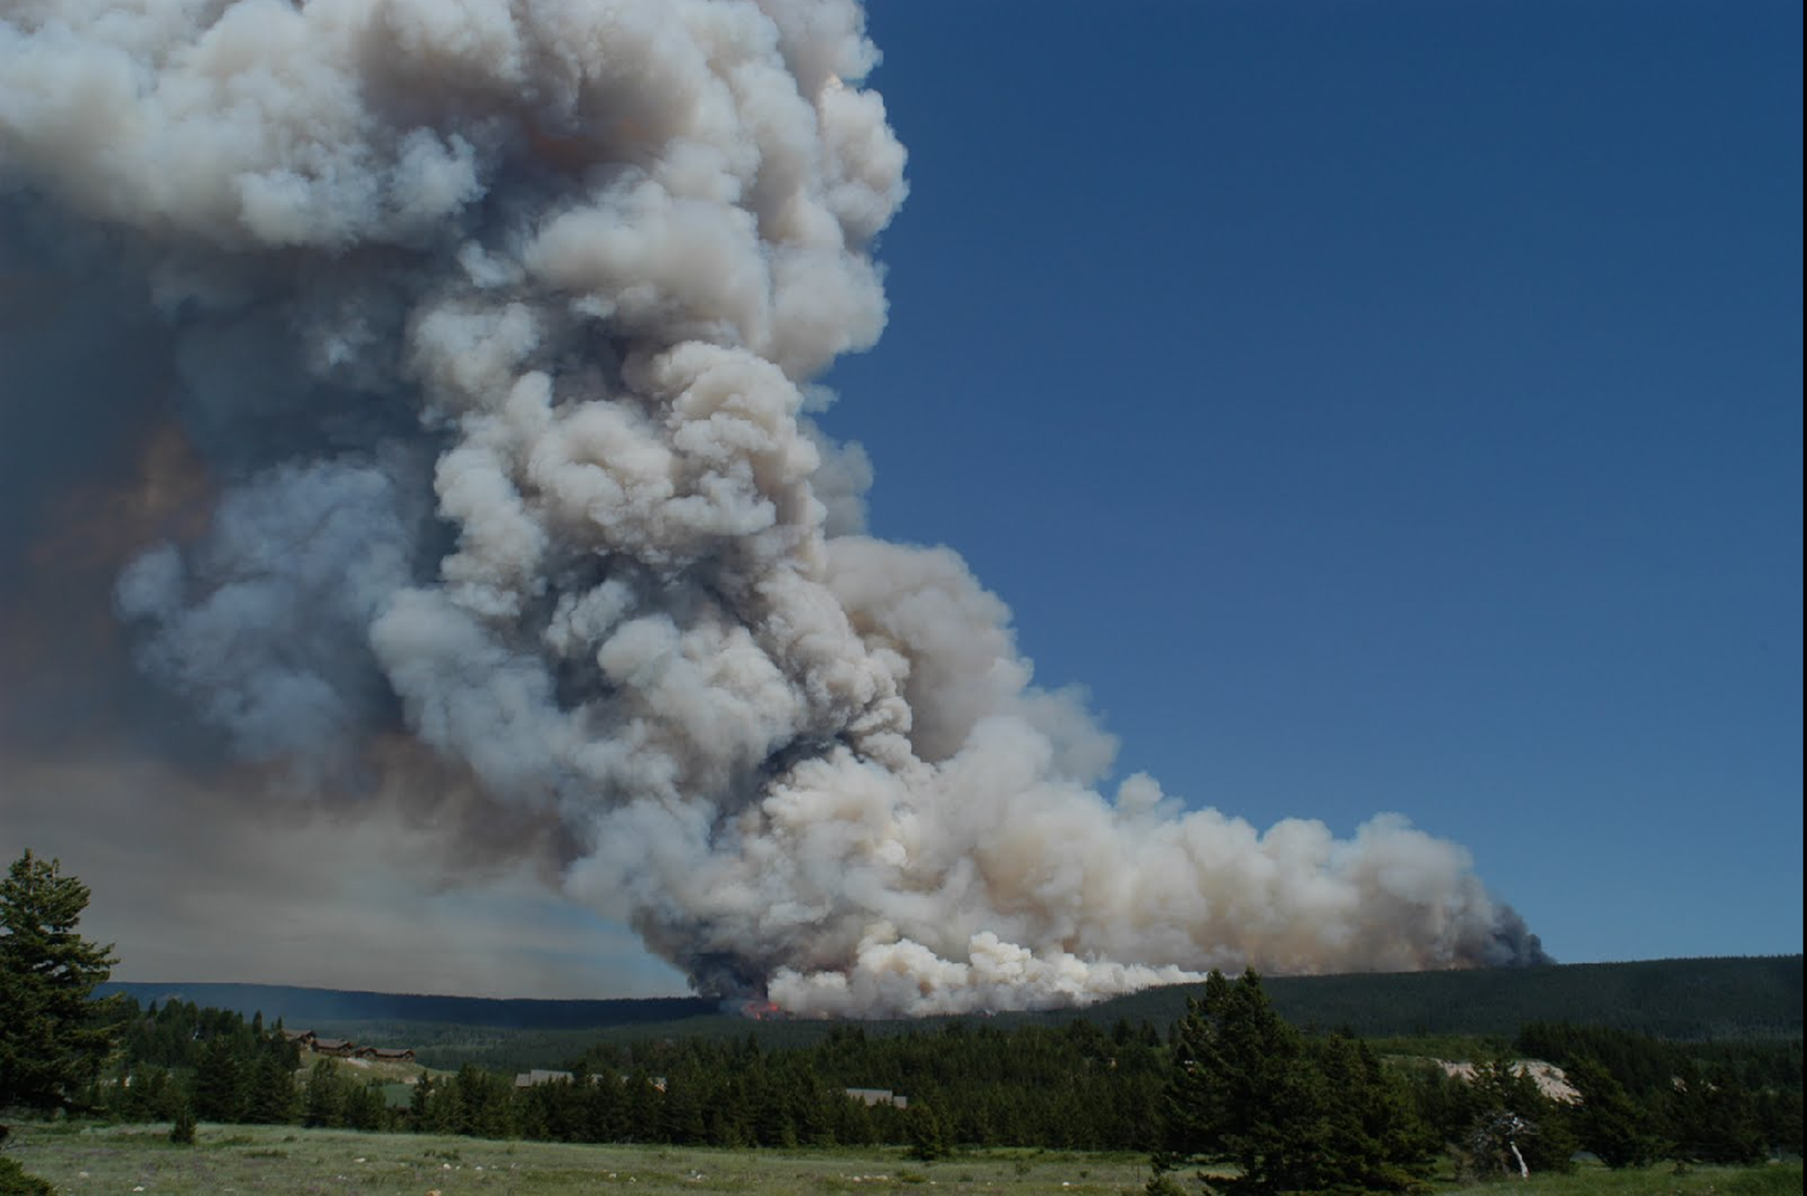
Exposure assessment difficulties
Sparse air pollutant monitoring network
Many PM_{2.5} monitors only measure every sixth or third day
Leads to spatial and temporal averaging of exposure measurements
But, smoke plumes migrate quickly, changing exposures over smaller spatial and temporal scales
Image: National Interagency Fire Center, Fox Fire East, Glacier 2000
Notes:
One of the issues that immediately becomes apparent when trying to investigate the health effects of wildland fire smoke is the difficulty of assessing exposure in a population.

Slide 5
Previous and Current ML work
Dr. Colleen E. Reid modeled Northern CA 2008 wildfire season for her dissertation
Reid et al., Spatiotemporal Prediction of Fine Particulate Matter During the 2008 Northern California Wildfires Using Machine Learning. Environ. Sci. Technol. 2015, 49, 3887−3896
Current Project – Scaling up:
Multi-year, 11 western states
Similar modeling (e.g., Di et al., 2016) don’t perform well in western US and fires were left out
More than EPA monitors (Forest Service, TEOM, states, field campaigns, etc.)
❋ If you have PM_{2.5} monitor data – we would like to include it in our study ❋
Plan to do ensemble of different machine learning algorithms
Di et al. Environ. Sci. Technol. 2016, 50, 4712−4721

Slide 6
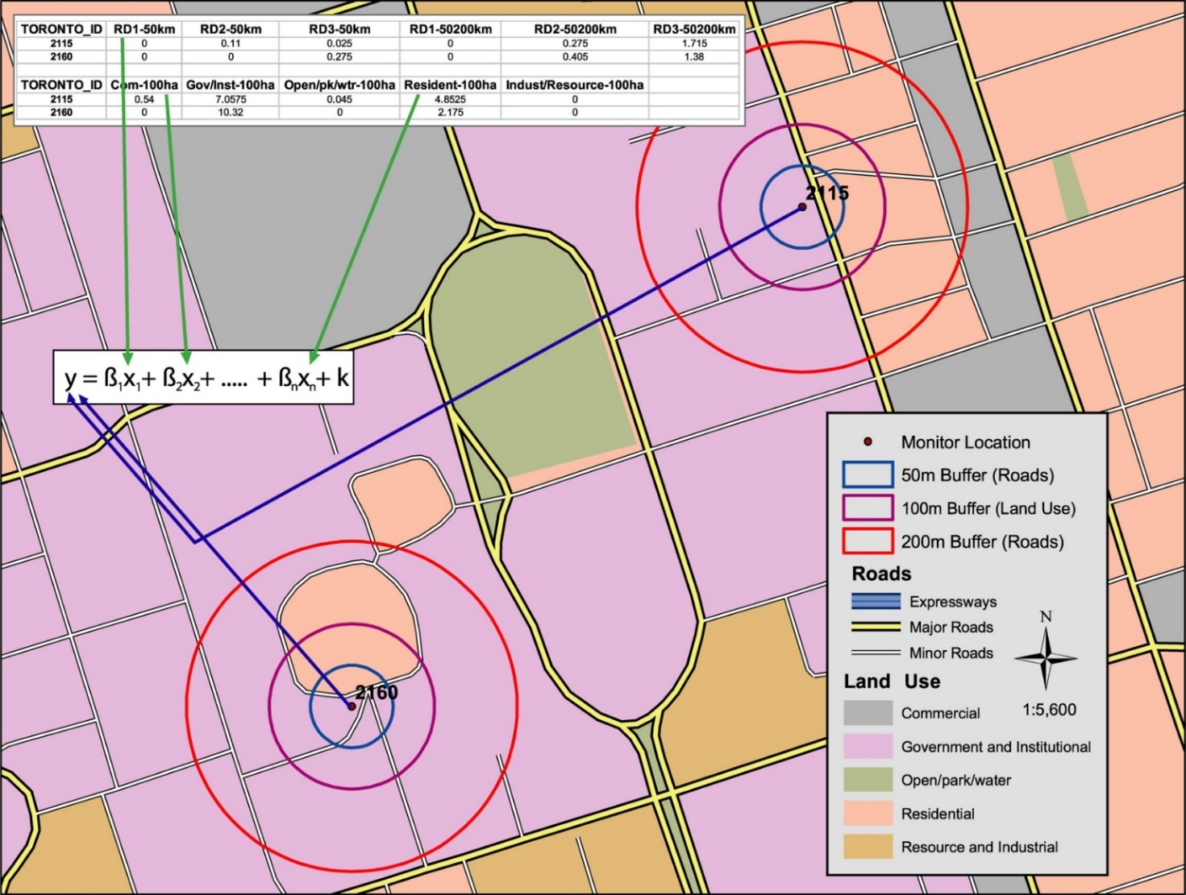
Methods – adapt land use regression modeling with machine learning
Image: courtesy of Mike Jerrett
Notes:
I bring in the text box to say ways in which I adapted land use regression for this purpose – instead of long-term average, used spatiotemporal predictors to allow daily estimation and used machine learning to select between a lot of non-linear models

Slide 7
Methods – adapt land use regression modeling with machine learning
Include novel spatiotemporal datasets
Apply machine learning methods to
Select from a long list of predictor variables
Select from a variety of statistical algorithms
Image: courtesy of Mike Jerrett
Notes:
I bring in the text box to say ways in which I adapted land use regression for this purpose – instead of long-term average, used spatiotemporal predictors to allow daily estimation and used machine learning to select between a lot of non-linear models

Slide 8
2008 northern California wildfires
Lightning storm on June 20-21, 2008
Over 6000 lightning strikes
Thousands of fires
Smoke covered large population areas for weeks (est. 10-12 million people exposed)
Potential for adverse health effects on large population
Reid et al., Spatiotemporal Prediction of Fine Particulate Matter During the 2008 Northern California Wildfires Using Machine Learning
Environ. Sci. Technol. 2015, 49, 3887−3896
Notes:
I became interested in this when I was working for the EPA in San Francisco – there had just been an intense wildfire that had caused many people to call in to the air office complaining of the health impacts. But the air team had no idea if this was

Slide 9
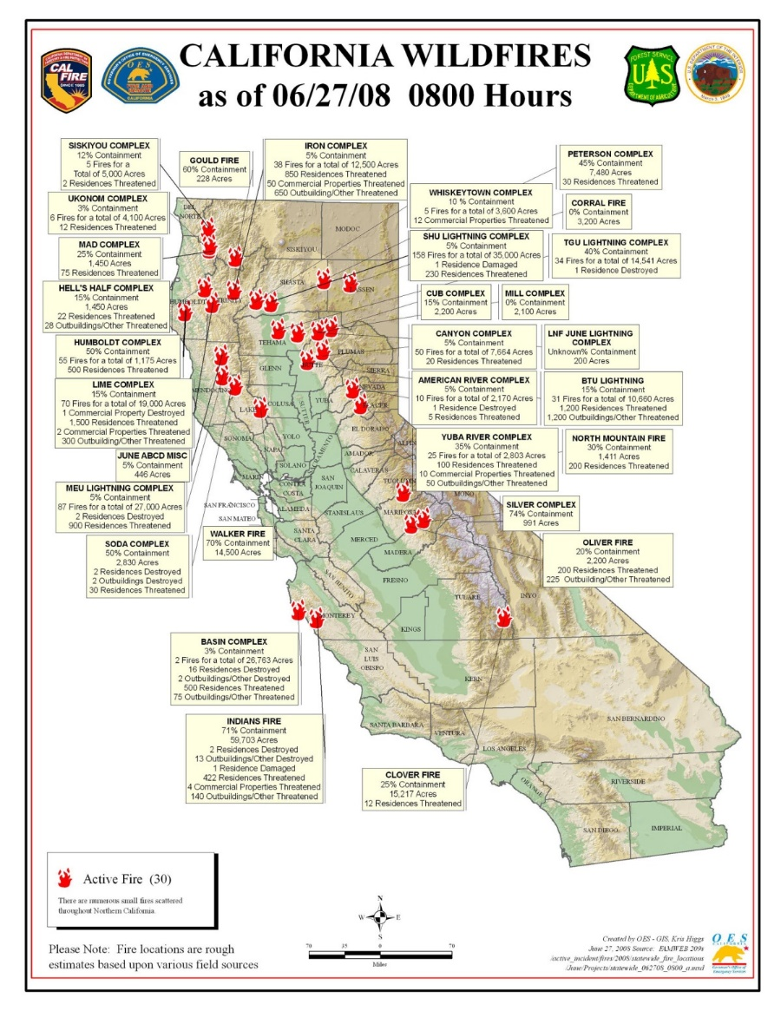
2008 northern California wildfires
Lightning storm on June 20-21, 2008
Over 6000 lightning strikes
Thousands of fires
Smoke covered large population areas for weeks (est. 10-12 million people exposed)
Potential for adverse health effects on large population
Reid et al., Spatiotemporal Prediction of Fine Particulate Matter During the 2008 Northern California Wildfires Using Machine Learning
Environ. Sci. Technol. 2015, 49, 3887−3896
Notes:
I became interested in this when I was working for the EPA in San Francisco – there had just been an intense wildfire that had caused many people to call in to the air office complaining of the health impacts. But the air team had no idea if this was

Slide 10
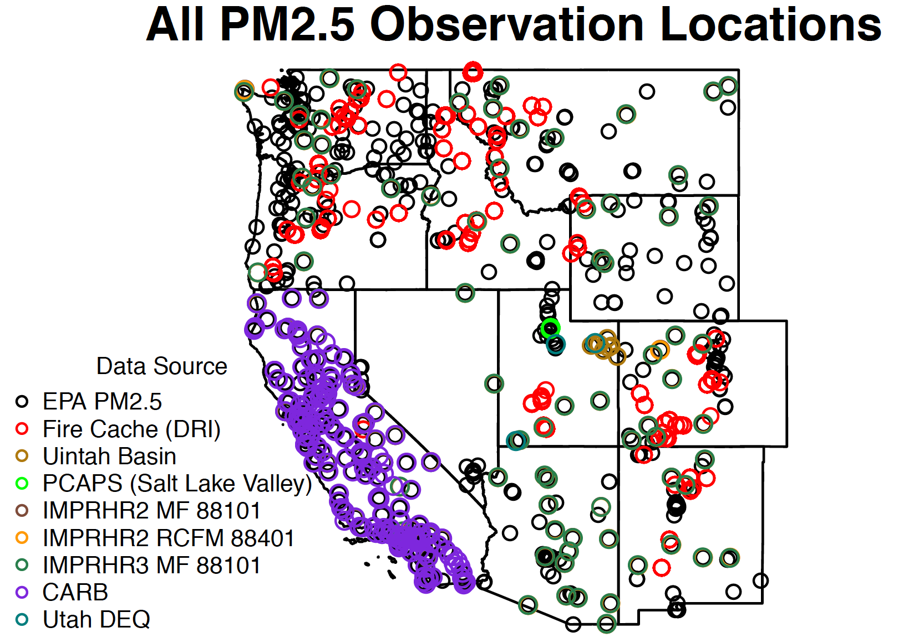
# locations
(with lots of overlap)
587
3439
9
7
95
95
91
190
3

Slide 11
Variables | Data Source | Temporal Resolution | Spatial Resolution | Buffer Size
Dependent Variable
PM2.5 from monitoring stations | US EPA, states Federal Land Manager Environmental Database, Fire Cache Smoke Monitor Archive, IMPROVE Network, academic research groups | Daily or hourly | point
Spatiotemporal Variables
GOES Aerosol and Smoke Product (GASP) AOD | NOAA | Hourly | 4 km
Multi-Angle Implementation of Atmospheric Correction (MAIAC) AOD | NASA | Daily | 1 km
MODIS Active Fire Detection | NASA | Daily | 1 km
VIIRS Fire Occurence | NASA | Daily | 375 m
Hazard Mapping System (HMS) Smoke and Fire Product | NOAA | Daily | 4km | 25km, 50, 100km, 500km, 1000km, 2000km
MODIS Normalized Difference Vegetation Index (NDVI) | NASA | Monthly | 1 km
14 Meteorological Variables | NOAA: North American Mesoscale (NAM) Forecast System | 6-Hourly | 12 km
Spatial Variables
Elevation (m) | USGS | Nominal 2-month cycle | 1 arc-second
Percentages of land cover types | National Land Cover Database 2011 | Every 5 years | 30 m | 1km
Kilometers of highway within buffer zones | National Highways Planning Network, US DOT |  |  | 100, 250, 500, and 1000 m
Temporal Variables
Julian Date |  | Daily
Weekend |  | Daily
Notes:
We amassed a very large dataset to do this

Slide 12
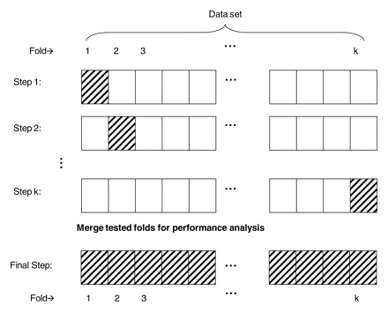
Statistical Methods – Machine Learning
10-fold cross validation within each algorithm
To choose the covariates
To choose the tuning parameters of the algorithm
Minimize the CV-RMSE
Caret package in R
May do spatial, temporal CV
leave out airshed or year

Slide 13
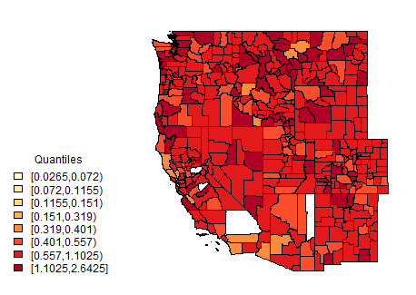
Status of Project
Assembling data
GASP AOD 2008-2011
MAIAC AOD 2008-2014
Highways
NED (elevation)
NLCD (land cover)
NAM (weather) 18Z run 2008-2011 (with gap)
Others in Progress
Starting to run ML models
MAIAC July 11, 2008

Slide 14
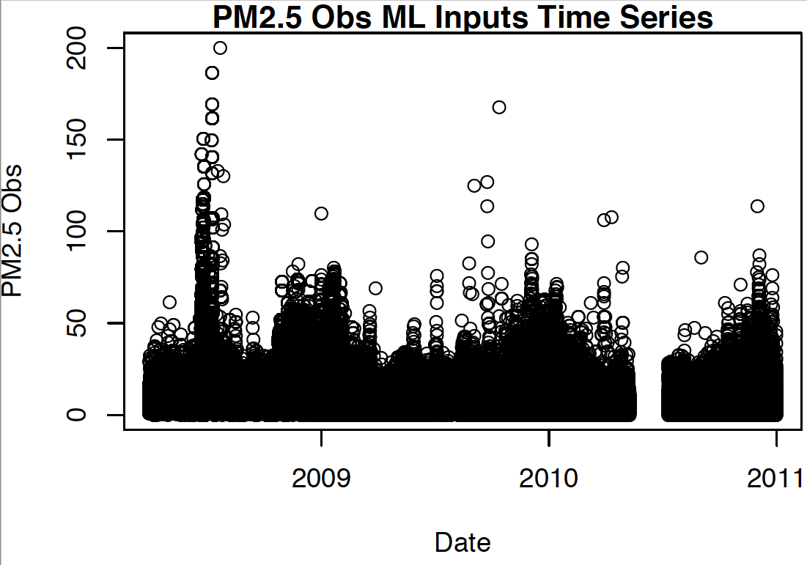
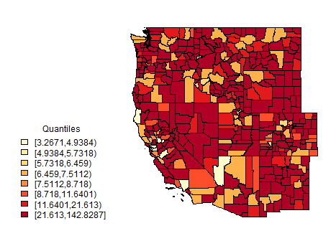
PM_{2.5} Time series
PM2.5 Observations July 11, 2008

Slide 15
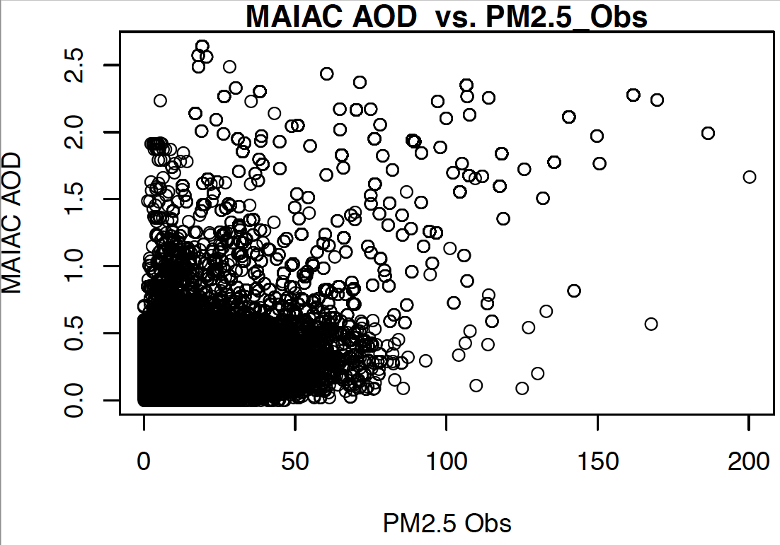
MAIAC AOD
Multi-Angle Implementation of Atmospheric Correction Aerosol Optical Depth
Aqua-Terra MODIS Satellites
Daily, 1 km resolution
Available 2/26/2000 to present

Slide 16
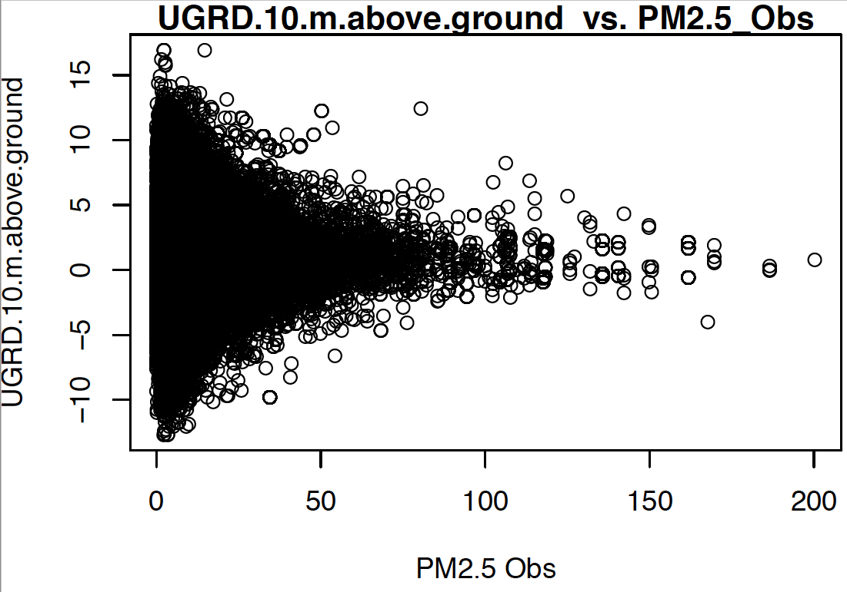
A check on the data: Higher PM_{2.5} with calm winds

Slide 17
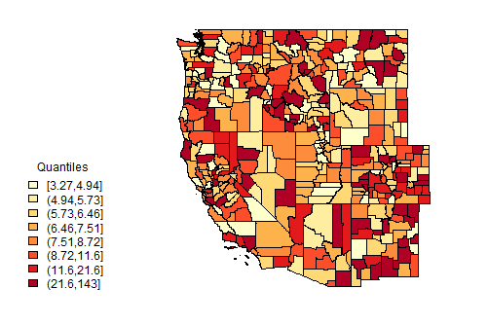
Extremely Preliminary Results
PM2.5 Observations July 11, 2008
PM2.5 Predictions July 11, 2008

Slide 18
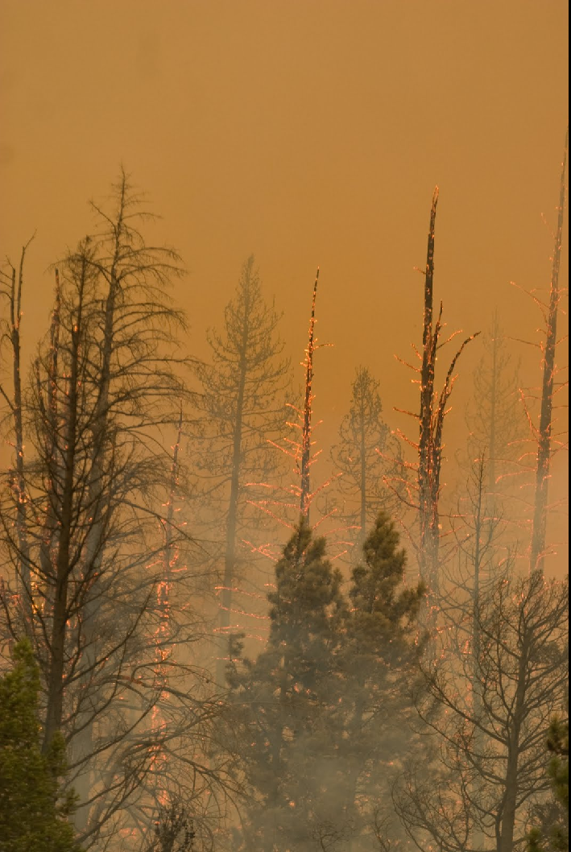
Next Steps and Future Plans
Finish data assimilation
❋ Looking for more PM_{2.5} data ❋
ML modeling
Ensemble modeling
Random Forest, others
Cross validation by region/time instead of 10-fold
Model by Region:
Predictor relationships could be different
Pull in CTM model output
❋ Looking for available data ❋
Connect ML estimates to medical data for epidemiological analysis
Flexible Geographic Resolution
County centroid
Population-weighted county centroid
ZIP code
Geo-coded address
Image: National Interagency Fire Center, Castle Rock Fire, Ketchum ID, 2007

Slide 19
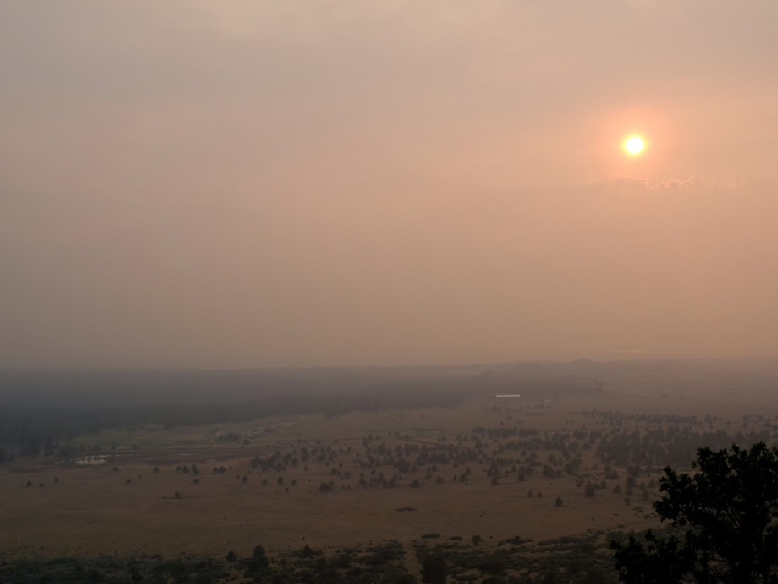
Thank You!! Questions?
Melissa May Maestas, PhD
Melissa.Maestas@Colorado.edu
Colleen E. Reid, PhD, MPH
Colleen.Reid@Colorado.edu
Gina Li, MA-candidate
Ellen Considine, BS-candidate
Funding: CU Boulder Grand Challenge to Earth Lab
Image: National Interagency Fire Center, NorCal Fires, 2008

Slide 20
Extra Slides

Slide 21
NAM Meteorological Variables
VariableNumber | VariableName | VariableCode | AtmosLevelName | AtmosLevelCode | Units | file_type | time frame | 24-hr summary
384 | Planetary Boundary Layer Height | HPBL | surface | surface | m | grib2 | anl | max
321 | Temperature | TMP | 2 m above ground | 2 m above ground | K | grib2 | anl | max
321 | Temperature | TMP | 2 m above ground | 2 m above ground | K | grib2 | anl | mean
324 | Relative Humidity | RH | 2 m above ground | 2 m above ground | % | grib2 | anl | mean
323 | Dew Point Temperature | DPT | 2 m above ground | 2 m above ground | K | grib2 | anl | mean
326 | Total Precipitation | APCP | surface | surface | kg/m^2 | grib2 | 0-0 day acc fcst | sum
316 | Water Equivalent of Accumulated Snow Depth | WEASD | surface | surface | kg/m^2 | grib2 | anl | sum
317 | Snow Cover | SNOWC | surface | surface | % | grib2 | anl | max
325.1 | U-Component of Wind | UGRD | 10 m above ground | 10 m above ground | m/s | grib2 | anl | mean
325.2 | V-Component of Wind | VGRD | 10 m above ground | 10 m above ground | m/s | grib2 | anl | mean
1 | Pressure Reduced to MSL | PRMSL | mean sea level | mean sea level | Pa | grib2 | anl | mean
297 | Pressure | PRES | surface | surface | Pa | grib2 | anl | mean
246 | Vertical Velocity (Geometric) | DZDT | 850 mb | 850 mb | m/s | grib2 | anl | mean
203 | Vertical Velocity (Geometric) | DZDT | 700 mb | 700 mb | m/s | grib2 | anl | mean

Slide 22
Source: Reid et al. 2015. Spatiotemporal Prediction of Fine Particulate Matter During the 2008 Northern California Wildfires Using Machine Learning. Environmental Science & Technology.

Slide 23
Predictions for the top two models agreed with visible imagery
Source: Reid et al. 2015. Spatiotemporal Prediction of Fine Particulate Matter During the 2008 Northern California Wildfires Using Machine Learning. Environmental Science & Technology.
Notes:
With noted discrepancies due to the one time point of the visible imagery and the model was for a 24-hour average, and also the discrepancy of visible could have more smoke aloft whereas the model was trained to best estimate exposures at ground-level.

Slide 24
Variable Importance
Average Variable Importance
GASP AOD | 1088.40
distance to the nearest fire cluster | 327.99
WRF-Chem | 266.49
Julian date | 263.31
Surface pressure | 201.03
Local AOD | 195.17
sea level pressure | 182.81
Relative humidity | 175.75
V component of wind speed | 157.06
U component of wind speed | 135.87
X-coordinate | 134.86
MODIS AOD | 130.63
temperature at 2 meters | 116.02
Y-coordinate | 122.27
dew point temperature | 96.16
fire counts in nearest cluster / distance | 95.87
elevation | 75.52
planetary boundary layer height | 84.49
% urban land use within 1 km | 72.40
sum of traffic counts within 1 km | 71.98
% vegetated land use within 1 km | 37.64
Reid et al. 2015. Environmental Science & Technology

Slide 25
Reid et al. 2015. Environmental Science & Technology
Notes:
We also ran the model with fewer inputs and it could still do well – this speaks to the role of these learners that they can handle redundancies in the data (should not be used for inference but great at prediction).

Slide 26
Conclusions – Exposure Assessment
Combining multiple spatiotemporal datasets including satellite data and/or chemical transport model data could predict ground-level PM_{2.5} well during a wildfire
Tree-based algorithms predicted ground-level PM_{2.5} better than linear or other commonly used statistical models (e.g. GAM)
Data that could apply to any fire, “universal” variables, could predict ground-level PM_{2.5} almost as well as the full model

Slide 27
Statistical Algorithms
Random Forest
Tree bagging
Generalized Boosting Models (GBM)
Generalized Linear Models (GLM)
GLM with penalized maximum likelihood (glmnet)
Multivariate adaptive regression splines (Earth)
Lasso regression
Ridge regression
Support Vector Machines
Gaussian Processes
Generalized Additive Models (GAM)
K nearest neighbors regression
Reid et al. 2015. Environmental Science & Technology

Slide 28
Spatiotemporal exposure data sources
Aerosol optical depth (AOD) satellite data
Benefits – covers the whole land area and has temporal coverage of more than once a day
Drawbacks – full column aerosol loading not just where people breathe, just measures during daylight hours
Incomplete data due to cloud cover, missing retrevals, resolution (improving)
Chemical transport models
Benefits – can extract pollution estimates at ground level and covers whole land area
Drawbacks – modeled rather than measured data, uncertainties in the inputs, particularly the emissions estimates from wildfires
Notes:
Could we combine monitoring data, AOD, and CTM data in a meaningful way?

Slide 29
Variables | Data Source |  | Temporal Resolution | Spatial Resolution
Dependent Variable
PM_{2.5} from monitoring stations (N=121) | US EPA, California Air Resources Board, Air Districts, and US Forest Service |  | Daily or hourly
Spatiotemporal Variables
GASP AOD | National Oceanic and Atmospheric Administration |  | Half-hourly, daylight | 4 km
MODIS AOD | NASA |  | Twice daily | 10 km
Local AOD | Sonoma Technology, Inc. |  | Daily | 0.5 km
WRF-Chem PM_{2.5} (µg/m³) | National Center for Atmospheric Research |  | Hourly | 12 km
Distance to nearest cluster of active fires (m) Counts of fires in nearest cluster / distance | Derived from USDA Forest Service Remote Sensing Applications Center |  | Daily
Relative Humidity (%) Sea level pressure (Pa) Surface pressure (Pa) Planetary boundary layer height (m) U-component of wind speed (m/s) V-component of wind speed (m/s) Dew point temperature (K) Temperature at 2 m (K) | Rapid Update Cycle |  | Daily | 13 km
Spatial Variables
X-coordinate (m) Y-coordinate (m) | U.S. Environmental Protection Agency Air Quality System
Counts of traffic within 1 km | Dynamap 2000, TeleAtlas |  | Annual | 1 km
% of urban land use within 1km % of agricultural land use within 1km % of vegetation land use within 1km Any High intensity land use within 1km | 2006 National Land Cover Database |  |  | 1 km
Elevation (m) | National Elevation Dataset 2010
Binary indicator variables for air basin | California Air Resources Board |  |  | Air Basin
Population Density | U.S. Census 2000 |  |  | Block Group
Temporal Variables
Julian Date Weekend |  |  | Daily
Reid et al. 2015. Environmental Science & Technology
Notes:
We amassed a very large dataset to do this

Slide 30
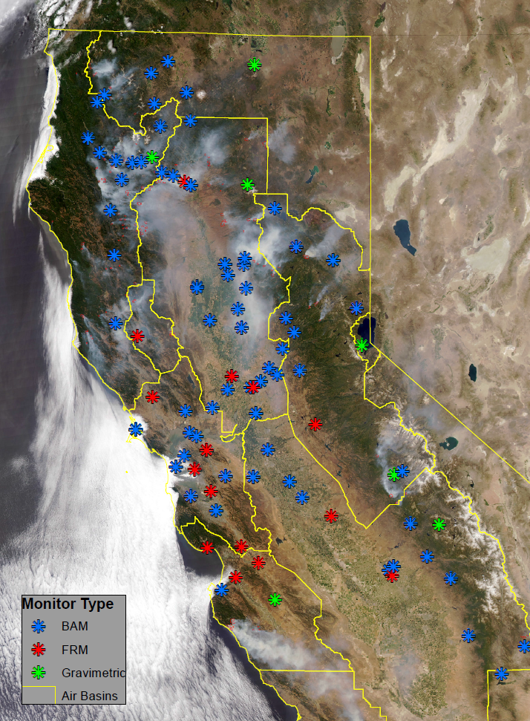
PM_{2.5} Monitoring Data
121 PM_{2.5} Monitors
EPA, CARB, USFS
38 FRM
16 other gravimetric
67 BAMs
Co-located FEM monitors agree with FRM (Pearson r values 0.94 – 1.00).

Slide 31
Statistical Methods – Machine Learning
29 predictor variables
121 monitoring locations
11 statistical algorithms
10-fold cross validation within each algorithm
To choose the covariates
To choose the tuning parameters of the algorithm
Minimize the CV-RMSE
Caret package in R
Functions rfe and train

